Slide 1
SYSTEMIC SCLEROSIS
Dr emad abokhabar
Lecturer of internal medicine and nephrlogy
Sohag university

Slide 2
Introduction
Chronic systemic disorder of unknown etiology.
Characterised by thickening of the skin (scleroderma) and distincitive involvement of multiple internal organs most notably lungs , GIT , heart ,kidneys.
Skin induration limited to fingers( sclerodactyly)
No skin induration (SSc sine scleroderma)
RAYNAUD’S phenomenon is predominant feature seen.

Slide 3
Definition
SSc is a multisystemic ,autoimmune disease affecting small arteries, microvessels and fibroblasts resulting in vascular obliteration, collagen accumulation and scarring (fibrosis) of skin and internal organs.
Serologic specificity of the disease is the presence of ANA ,directed against cellular nuclear enzymes, like DNA topoisomerase -1 (anti –Topo 1 ) and RNA polymerase, as well as centromeric proteins (anticentromere Ab)

Slide 4
Diagnostic criteria
The AMERICAN COLLEGE OF RHEUMATOLOGY (ACR) criteria for the classification of systemic sclerosis.
One major criteria, two or more minor criteria for diagnosis.
MAJOR criterion : PROXIMAL scleroderma –characterized by SYMMETRICAL thickening, tightening and induration of the skin of the fingers and the skin proximal to the MCP /MTP joints. these changes may affect the entire extremity, face, neck, trunk.
MINOR
1.SCLERODACTYLY – thickening,induration,tightening of the skin limited only to fingers.
2.DIGITAL PITTING SCARS/LOSS OF SUBSTANCE FROM THE FINGER PAD –due to ischemia.
3.BIBASILAR PULMONARY FIBROSIS- b/l reticular pattern of linear or lineonodular densities in basilar portions of the lung on CXR.diffuse mottling/honey comb lung not attributable to primary pulmonary disease

Slide 5
Pathology
Following pathogenic mechanisms always present:
Endothelial cell injury
Fibroblast activation
Cellular and humoral immunologic derangement.
Activation of the immune system is an outstanding disease feature. –autoantibodies, perivascular lymphocytes (cd4 T )
Chronic forms of GVHD shares features of SSc.

Slide 6
Clinical description
The condition may be divided into different subtypes
DIFFUSE CUTANEOUS SSc (DcSSc)
LIMITED CUTANEOUS SSc (LcSSc )
SYSTEMIC SCLEROSIS SINE SCLERODERMA
DcSSc – abrupt in onset, RP is common, thickening of trunk ,acral skin edema –earliest features, PF, renal crises.
LcSSc – skin induration limited to hands, face, feet—CREST.
SSSc ---visceral disease without skin involvement.

Slide 7
SUBSETS OF SYSTEMIC SCLEROSIS

Slide 8
Clinical features
RAYNAUD’S PHENOMENON:RF
Episodic vasoconstriction in the fingers and toes.
Tip of the nose , earlobes can also be affected.
Triggers – exposure to cold,↓ temperature,stress,vibration.
↑ frequency ,severity in winter.
Typical attack : PALLOR → CYANOSIS → ERYTHEMA.
Vasoconstriction → ischemia → reperfusion.
women > men
PRIMARY –exaggerated physiological response to cold.
SECONDARY --complication of SSc…

Slide 9
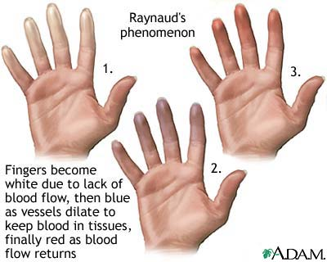
Raynaud’s phenomenon
Primary – no underlying causes
Positive family h/o
Absence of digital necrosis
No ulceration , gangrene
Negative ANA test
Secondary ---- > 30 yrs
More severe
Assosciated with ischemia, infarction of digits.

Slide 10
SKIN features
Clinically evident skin thickening is the HALLMARK of SSc—distinguishes it from others..
Symmetrical ,B/L
Skin is firm ,coarse and thickened.
Darkly pigmented extremities and trunk.
Diffuse tanning in the absence of exposure to sun –very early feature.
Vitiligo like hypopigmentation –in dark skinned individuals.
Pigment loss spares perifollicluar areas – salt and pepper appearance of skin –scalp ,upper back ,chest.
Loss of transverse creases on dorsum of fingers
Fixed flexion deformity of fingers

Slide 11
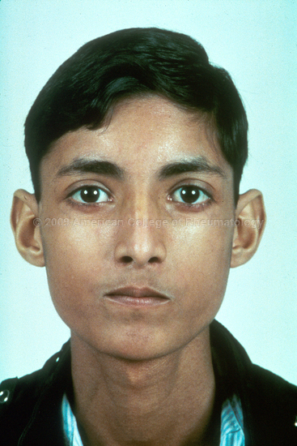
FACE – mouth fish appearance –
Skin is firmly bound to subcutaneous fat –
thinning and atrophy.
MACULAR telangiectasia –localised scleroderma
ATROPHY of skin – slow healing ulceration on extensor surface of PIP joints.
DIGTIAL pits – healed ischemic ulcers.
Resorption of terminal phalanges – acro osteolysis.
Calcium deposits in skin ,soft tissue.. CREST syndrome –
Finger pads, palms, extensor surfaces.
Firm ,non tender subcutaneous lumps– ulcerate through skin –chalky white matter.

Slide 12
Salt and pepper appearance of skin

Slide 13
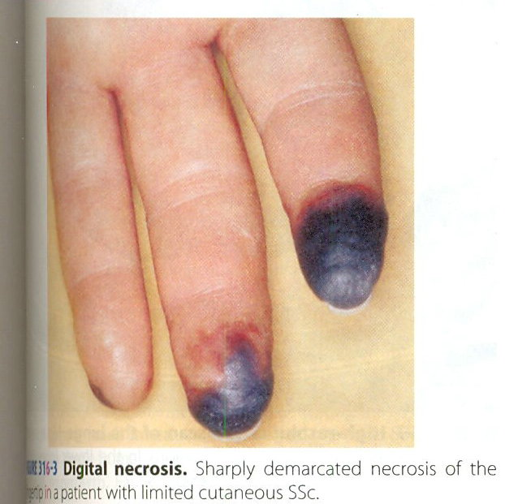
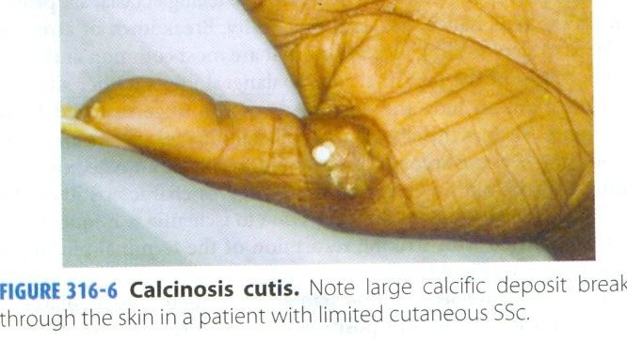

Slide 14
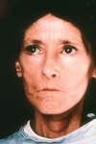
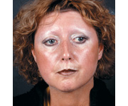
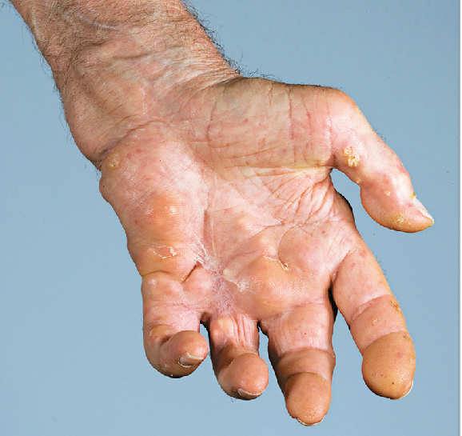
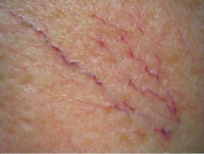
Skin features
Calcinosis telangiectsias

Slide 15
Pulmonary features
Leading cause of death.
ILD, PAH
Less frequently –aspiration pneumonitis , pulmonary hemorrhage , obliterative bronchiolitis , pleural involvement , restrictive ventilatory defect due to chest wall fibrosis , spontaneous pneumothorax.
↑ broncho alveolar carcinoma
Asymptomatic until advanced.

Slide 16
Pulmonary Arterial Hypertension
Mean Pulmonary arterial pressure > 25 mm Hg at rest.
12-25% have PAH
In assosciation with ILD/solitary.
Usually downhill course –RHF –death.
Asymptomatic, exertional dyspnea.
PASP >40 mm Hg at rest in 2d echo.
Right heart catheterisation accurate.
Increased BNP.
Prognosis ∝ degree of pulmonary artery pressure elevation.

Slide 17
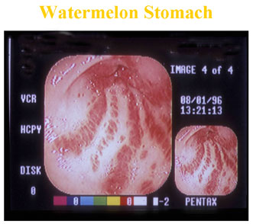
GASTROINTESTINAL
90% Pts.
Asymptomatic /weight loss
Abnormal motility of intestines.
Prominent atrophy ,fibrosis of smooth muscle, intact mucosa, obliterative small vessel vasculopathy – all over GIT .
↓Oral aperture
Periodontal disease
GERD – early
↓LES pressure
Increased emptying time.
Gastroparesis – early satiety
Distention, abd pain
Increased reflux

Slide 18
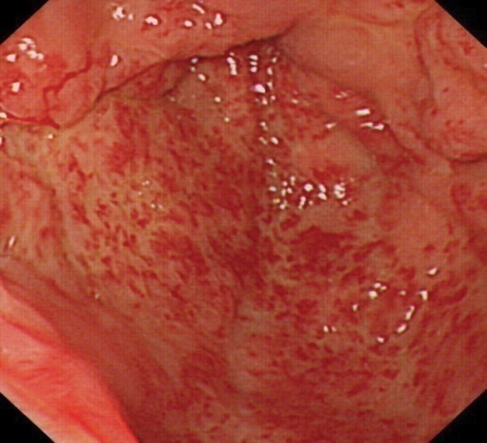
GIT
GASTRIC VASCULAR ECTASIAs – seen in the antrum.
Subepithelial lesions
Diffuse small vessel vsculopathy
Watermelon appearance
Recurrent GI bleed occult
Fat ,protein malabsorption,vitamin b12
Wide mouth sacculations in the colon occur –perforation.
Pneumatosis cystoides intestinalis
Primary biliary cirrhosis may coexist.
May present with acute abdominal pain recurrent

Slide 19
RENAL
HTN,chronic non progressive proteinuria.
SCLERODERMA renal CRISIS –dreadful complication of SSc.
20-25% pts
< 4 yrs of onset of diseases
It is due to OBLITERATIVE VASCULOPATHY of renal cortical arteries.
↓RBF → JGA hyperplasia → renin secretion → RAAS → renal vasoconstriction →malignant HTN.
Localised scleroderma –infrequent development.
Prednisolone to be avoided.

Slide 20
RENAL
Presentation –abrupt onset of malignant HTN, severe headache, blurred vision, chest pain.
10% normal BP – normotensive renal crises.
Urinalysis -- proteinuria, microscopic hematuria, fragmented RBCs
Rapidly progressive oliguric renal failure follows
Creatnine > 3 mg/dl at presentation –poor prognosis.—permanent hemodialysis – high mortality,
Prompt use of ACEI to make BP under control before renal failure occurs – imporved prognosis.

Slide 21
Cardiac
Myocardial ,pericardial ,conduction abnormalities.
Can occur secondary to renal ,pulmonary involvement.
LVDD –due to HTN ,myocardial fibrosis.
Asymptomatic until HF ,arryhthmias occurs.
Myocarditis in assosciation with inflammatroy polymyositis.
Conduction defects due to fibrosis of conduction system.
Pericardial effusion.

Slide 22
Musculoskeletal
CARPAL TUNNEL SYNDROME.
Early disease –generalised arthralgia, stiffness.
Joint mobility affected in diffuse disease.
HANDS –PIP joints, wrists.
Tendon friction rubs are present.—extensive fibrosis, adhesion of tendon sheaths.
Muscle weakness due to disuse, malnutrition.
Chronic noninflammatroy myopathy is usually seen.
Bone resorption –a freq late complication –terminal phalanges –loss of distal tufts –ACRO OSTEOLYSIS.
Mandible affected—biting difficulty.

Slide 23
Other disease manifestations
Dry eyes,dry mouth –SICCA complex.
Biopsy of the minor salivaryglands –fibrosis rather than lymphocytic infitration.(sjogren’s syndrome)
Hypothyroidism –fibrosis of gland.
CNS is generally spared . Sensory trigeminal neuropathy due to fibrosis /vasculopathy can occur.
Pregnancy -adverse outcomes
Erectile dysfunction in the male.

Slide 24
Laboratory features
Anemia – frequent
Most common is mild normocytic /microcytic anemia –chronic inflammation
Serum iron is low or normal, ferritin is elevated.
Iron deficiency anemia –occ ult GI bleed (WATERMELON STOMACH),chronic esophagitis.
Macrocytic anemia – vitmainb12,folate,bacterial overgrowth,drugs.
Thrombocytopenia ,leukopenia –DRUG toxicity.
ESR is normal
Increased ESR –MYOSITIS ./ MALIGNANCY

Slide 25
ANTINUCLEAR ANTIBODIES
All patients of SSc
Highly specific are anti topoisomerase –I (Scl 70) and anti centromere Ab
Topoisomerase I ab 31% of dcSSc ,13% of lcSSc
Anticentromere ab in 38% of lcSSc,2% of dcSSc.
Antibody titers correlate with disease severity .

Slide 26
Differential diagnosis
Based on vascular changes:
1.PRIMARY raynaud’s phenomenon
2.physical trauma –jack hammer
3.chemical exposure
4.drugs toxins – toxic oil syndrome,ergotamine,Bblockers ,carbidopa,5HT .
5.SLE,DM/PM,RA.,cryoglobulinemia.
Based on skin changes
1.localized scleroderma
2.scleroderma like skin changes
3.metabolic –genetic disorders –scleredema/scleromyxedema
Based on visceral involvement
1.idiopathic pulmonary HTN
2.idiopathic pulmonary fibrosis
3.sarcoidosis
4.amyloidosis

Slide 27
Treatment
No therapy has been shown significantly to alter the natural h/o SSc till date.
Multiple interventions are avialable in alleviating the symptoms –slowing progression of organ damage.
Combination of drugs are used.
Physician –patient relationship to be mainatined.

Slide 28
Disease modifying treatments
Immunosuppressive agents –modest or no benefit in Rx of SSc.
Glucocorticoids - ↓ stiffness and aching in pts with early stage disease.
Do not influence the progression of skin/internal organ involvement.
↑risk of scleroderma renal crises at high doses.
Avoid if possible.
Low dose ,brief periods.
Cyclophosphamide –daily oral/IV in SSc related ILD.
Reduces the progression of ILD ,stabilises,improvement in skin induration.
Early stage SSc/extensive pulmonary involvement –candidate
Rx for 6- 12 months ,optimal duration not known.
Benefits <> toxicities
Bonemarrow suppression,opp infections,hemorhhagic cystitis,bladder Ca.

Slide 29
Disease modifying treatments
Methotrexate – modest therapeutic benefit
Potential profibrotic effects --? Use in fibrotic phase
Mycophenolate mofetil – improvement in skin induration
Immunomodulation – cyclosporine,azathioprine,extraxorporeal photopheresis,thalidomide,rapamycin.
Immune ablation with high dose chemotherapy followed by autologous peripheral stem cell reconstitution
Stem cell transplantation –experimental.

Slide 30
Rx of GI complications
Elevate head end of the bed.
Eat frequent small meals
PPIs ,H2B at higher doses are effective.
Laser photocoagulation –recurrent bleeding from watermelon stomach
Metronidazole,erythromycin,tetracycline –bacterial overgrowth.
Parenteral nutrition in case of severe disease.

Slide 31
Rx of PAH
Symptomatic – oral endothelin receptor antagonist
Diuretics
Oral anticoagulants
Digoxin
0 2 –nasal cannula
Sildenafil – short term benefit
Lung transplantation

Slide 32
Rx of Renal Crises
Medical emergency
Avoid NSAIDs, glucocorticoids
Rx –ACEI ,short term dialysis.
Kidney transplantation.

Slide 33
Skin care
5 mg prednisone
D penicillamine
Cyclophosphamide
Regular skin massage
Telangiectasia –laser pulse dyed laser
Finger tip ulcerations –occlusive dressings
Infected ulcers –topical Abs
Surgical debridement.

Slide 34
Poor prognosis
Male gender
young age of onset
African american race
Extensive skin thickening
Truncal involvement
Visceral organ involvement
Topoisomerase I ab
Increased ESR ,anemia ,proteinuria on initial presentation –high mortality…

Slide 35
Take home message
SSc is a chronic systemic disorder.
RULE out other causes.
Anti topoisomerase –dcSSc,anti centromere ab -LcSSc
After diagnosis risk stratify the patient.
Regular follow up and monitoring.
Patient education is needed.
Treatment is individualised.
Renal crises is an emergency.
ACEI are to be started in a pt with HTN.
No treatment for calcinosis cutis

